Slide 1
FINAL TERM REPORT OF
GENDER CLASSIFICATION IN SPEECH RECOGNITION USING A NEURO-FUZZY SYSTEM
A Graduate Project Final Term Report submitted to Manipal University in partial fulfilment of the requirement for the award of the degree of
BACHELOR OF TECHNOLOGY
In
Electronics and Communication Engineering
Submitted by
Neha Rawat Srishti Saha
110907090 110907266
Under the guidance of
Prof. T. K. Padma Shri
Associate Professor - Senior Grade Electronics and Communication
Department of Electronics and Communication Engineering, MIT, Manipal
Notes:
<number>

Slide 2
Contents
Introduction
Background theory
Methodology
Result analysis
Conclusion
Future Work
References
Department of Electronics and Communication Engineering, MIT, Manipal
Notes:
<number>

Slide 3

Introduction
Gender identification on the basis of the voice of a speaker consists of detecting if a speech signal is uttered by a male or a female.
Two main approaches can be used for gender identification:
Using frequency based features -pitch and formants
Using energy based features- short time energy (STE), zero crossing rate (ZCR) and energy entropy (EE)
Speaker Identification
Financial Transactions and Telephone Banking
Human Computer Interaction
Security Systems
Voice over Internet Protocol (VoIP)
1
Department of Electronics and Communication Engineering, MIT, Manipal
Notes:
<number>

Slide 4
Background theory - Features
Pitch
Pitch, in speech, is the relative highness or lowness of a tone as perceived by the ear, which depends on the number of vibrations per second produced by the vocal cords.
Zero Crossing Rate
The zero-crossing rate is the rate of sign-changes along a signal i.e. the rate at which the signal changes from positive to negative or back. This feature has been used heavily in both speech recognition and music information retrieval.
Short-Time Energy
The energy associated with speech is time varying in nature. Hence the interest for any automatic processing of speech is to know how the energy is varying with time and to be more specific, energy associated with short term region of speech.
Energy Entropy
Energy Entropy in a speech signal is defined as the sudden different changes in the energy level of the signal.
Formants
Formant Frequencies are concentrations of acoustic energy around a particular frequency in the speech wave and represent resonance in the vocal tract.
2
Department of Electronics and Communication Engineering, MIT, Manipal
Notes:
<number>

Slide 5
Background theory - ANFIS
An adaptive neuro-fuzzy inference system or adaptive network-based fuzzy inference system (ANFIS) is a kind of artificial neural network that is based on Takagi–Sugeno fuzzy inference system.
Since it integrates both neural networks and fuzzy logic principles, it has potential to capture the benefits of both in a single framework.
Hence, ANFIS is considered to be a universal estimator.
A standard ANFIS system consists of the following layers :
Layer 0 – Input Layer (a passive layer)
Layer 1 – Membership Function Layer
Layer 2 – Rule Layer
Layer 3 – Norm Layer
Layer 4 – Output Layer
Layer 5 – Final Output Layer
The system learns through Error Backpropagation Algorithm (EBPTA).
3
Department of Electronics and Communication Engineering, MIT, Manipal
Notes:
<number>

Slide 6
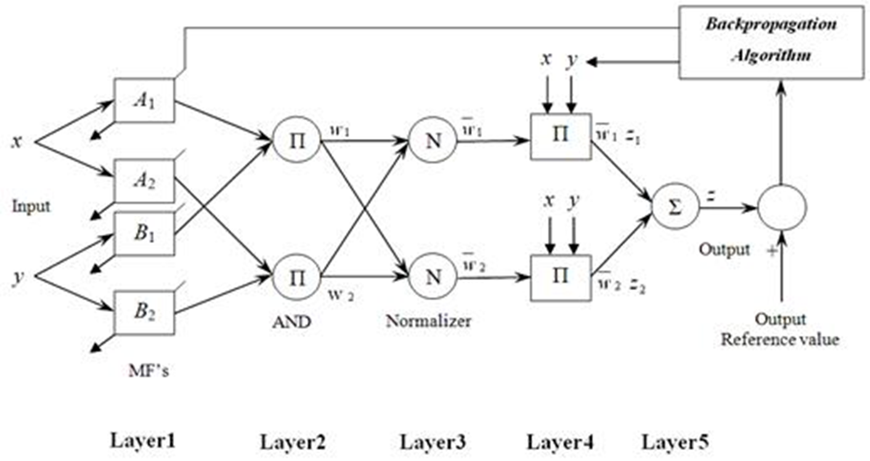
Background theory - ANFIS
4
Department of Electronics and Communication Engineering, MIT, Manipal
Notes:
<number>

Slide 7
Methodology - Features
PITCH
Method Used:
Autocorrelation Method
The autocorrelation function is the correlation of a waveform with itself. One would expect exact similarity at a time shift of zero, with increasing dissimilarity as the time shift increases.
The pitch is estimated based on detecting the highest value of the autocorrelation function in the region of interest.
For the following samples, we have taken the region of interest to be within 100-400 Hz.
The window function used for the short-term analysis of the extracted word is a non-overlapping rectangular window
w(n)= 1 ; n=0,1,…, N-1
A rectangular window provides better retention of temporal information without distortion in time-domain analysis of signals than other windows.
5
Department of Electronics and Communication Engineering, MIT, Manipal
Notes:
<number>

Slide 8
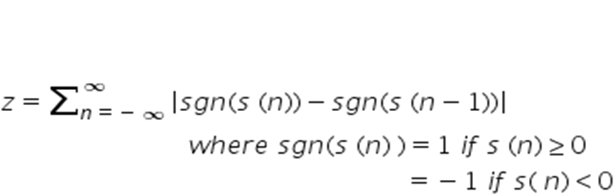
Methodology - Features
ZERO CROSSING RATE
Formula Used:
Method Used:
The window used for the short term analysis was a non-overlapping Rectangular Window and a window length of 201 was used.
The signum function is used to detect wherever a zero-crossing occurs and the same is stored to get the total number of zero crossings in the windowed speech signal.
The values obtained have been normalized for comparison.
6
Department of Electronics and Communication Engineering, MIT, Manipal
Notes:
<number>

Slide 9
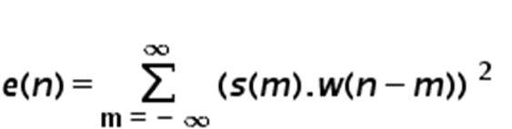
Methodology - Features
SHORT-TIME ENERGY
Formula Used:
Method Used:
The window used for the short term analysis was a non-overlapping Rectangular Window of length 201.
The energy for this short term region of speech is calculated.
The values are normalized for comparison.
7
Department of Electronics and Communication Engineering, MIT, Manipal
Notes:
<number>

Slide 10
Methodology - Features
ENERGY ENTROPY
Formula Used:
E = - Σ_{k} σ². log₂ (σ² )
Method Used:
A Rectangular Window is used for the frame-by-frame analysis.
The normalized energy is calculated for each sub window and summed up to calculate the normalized energy for that particular frame.
After a similar frame-by-frame computation for all the frames the total normalized energy of the signal is used in the above stated formula to compute the energy entropy of the signal.
A normalized value of the same is used for comparison.
8
Department of Electronics and Communication Engineering, MIT, Manipal
Notes:
<number>

Slide 11
Methodology - Features
FORMANTS
Method Used:
Formants are generally estimated using Linear Predictive Coefficients (LPCs).
Here we have used the pole-extraction method of formant estimation.
The resonant pole pairs of the LP model are selected as representative of formants.
The formant frequency is deduced from the angle of the pair.
Here, we have deduced the first and second formant frequencies to analyze the effect of gender on formants.
It has been observed that the first formant frequency varies greatly with respect to gender as opposed to other formant frequencies.
* (Source: Formants of children, women and men: the effects of vocal intensity variation , J. Acoust. Soc. Am. ,1999)
9
Department of Electronics and Communication Engineering, MIT, Manipal
Notes:
<number>

Slide 12
Methodology - ANFIS
ANFIS
Method Used:
The training data is consolidated in the form of an input/output matrix.
This training matrix is passed as an input parameter to the ANFIS to generate the input fuzzy inference structure.
This is generated using the function genfis1.
Each input parameter for the above is divided into three input and corresponding output membership functions – low, medium and high. The input membership functions are of the bell shape type and the output membership functions are linear (values ranging from 0 to 1).
10
Department of Electronics and Communication Engineering, MIT, Manipal
Notes:
<number>

Slide 13
Methodology - ANFIS
Training options like the maximum number of epochs, error goal, step size, step size decrease rate and step size increase rate are specified.
Display options are provided according to preference.
The optimization method is specified as hybrid or backpropagation. In this case, backpropagation method has been used.
The anfis function then returns the output fuzzy inference system into which the test data is passed to obtain the corresponding outputs as given by the ANFIS system.
The above steps are carried on for each of the five features and the results obtained from the five parallel ANFIS structures is then summed up and evaluated using a neuron or processing unit.
11
Department of Electronics and Communication Engineering, MIT, Manipal
Notes:
<number>

Slide 14
Methodology - ANFIS
The neuron checks the values and if found to be above the given threshold, the speaker is classified as ‘female’, otherwise ‘male’.
The results for the given test set are displayed on the command window.
12
Department of Electronics and Communication Engineering, MIT, Manipal
Notes:
<number>

Slide 15
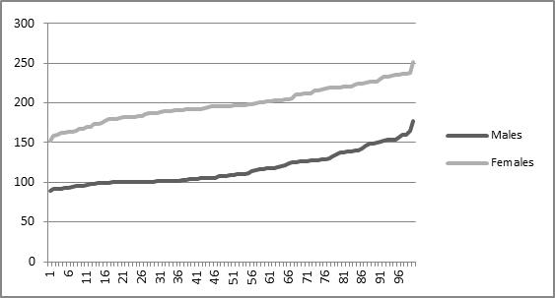
Result Analysis
Database Used: modified TIMIT database (derived from TIDIGITS)
Words uttered: ‘oh’, ‘zero’, ‘two’, ‘three’, ‘four’, ‘five’, ‘six’, ‘seven’, ‘eight’, ‘nine’
Sampling Frequency: 8 kHz
* Tabulated values mentioned in the report
PITCH
13
Department of Electronics and Communication Engineering, MIT, Manipal
Notes:
<number>

Slide 16
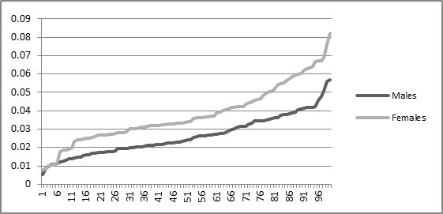
Result Analysis
ZERO CROSSING RATE
14
Department of Electronics and Communication Engineering, MIT, Manipal
Notes:
<number>

Slide 17
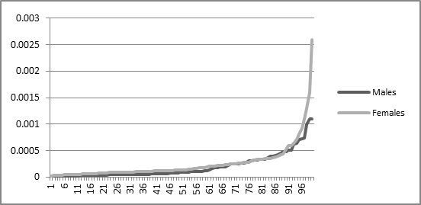
Result Analysis
SHORT-TIME ENERGY
15
Department of Electronics and Communication Engineering, MIT, Manipal
Notes:
<number>

Slide 18
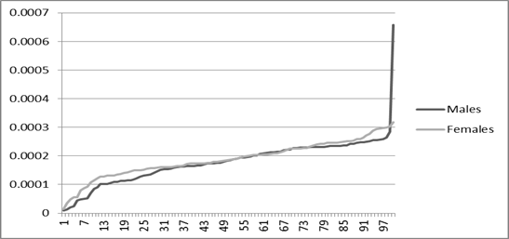
Result Analysis
ENERGY ENTROPY
16
Department of Electronics and Communication Engineering, MIT, Manipal
Notes:
<number>

Slide 19
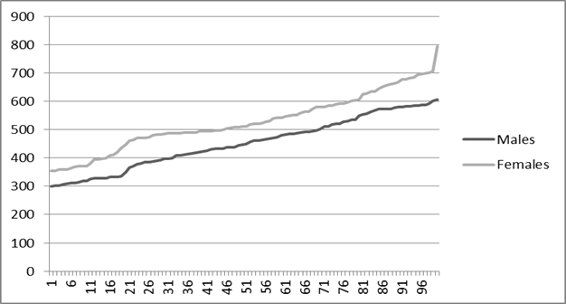
Result Analysis
FORMANTS
17
Department of Electronics and Communication Engineering, MIT, Manipal
Notes:
<number>

Slide 20
Result Analysis
ARTIFICIAL NEURAL NETWORK
No. of training samples: 180
No. of testing samples: 20
Threshold Value: 2.65
Training method used: Levenberg-Marquardt
Function used: trainlm
Toolbox used: Neural Network Toolbox, Matlab 2015a
18
Department of Electronics and Communication Engineering, MIT, Manipal
Notes:
<number>

Slide 21
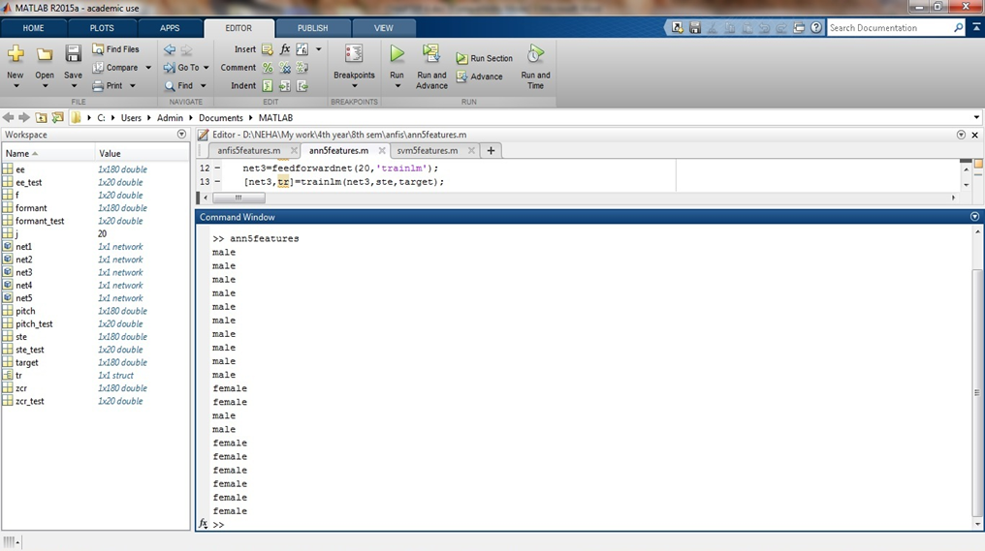
Result Analysis
Output Obtained:
Efficiency = (TP+TN) / (TP+FP+TN+FN)
= ((8+10) / 20) * 100 %
= 90.00 %
19
Department of Electronics and Communication Engineering, MIT, Manipal
Notes:
<number>

Slide 22
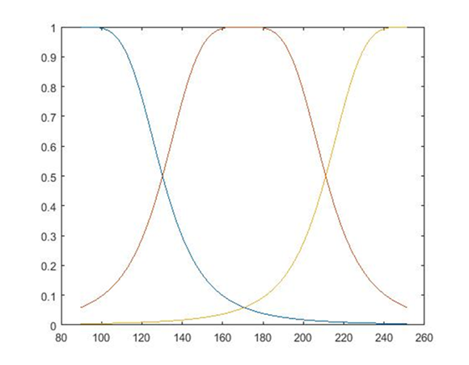
Result Analysis
ANFIS (Using only Pitch as a feature)
No. of training samples: 180
No. of testing samples: 20
No. of training epochs: 150
Threshold value: 0.55
Training method used: Error Backpropagation Training Algorithm (EBPTA)
Function used: anfis
Toolbox used: Neuro-Fuzzy Toolbox, Matlab 2015a
Input Membership Functions - Pitch
20
Department of Electronics and Communication Engineering, MIT, Manipal
Notes:
<number>

Slide 23
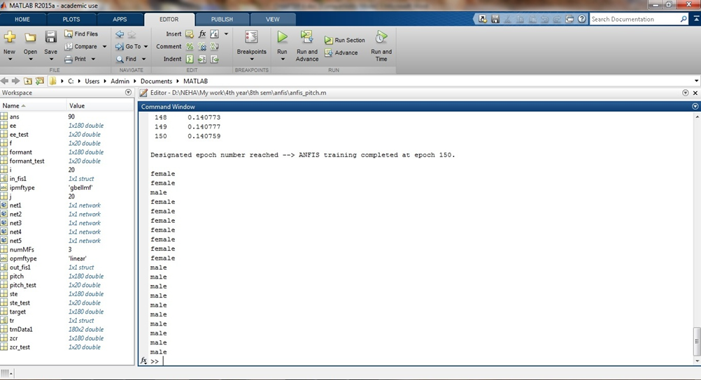
Result Analysis
Output Obtained:
Efficiency = ((9 + 10) / 20) * 100 %
= 95.00 %
21
Department of Electronics and Communication Engineering, MIT, Manipal
Notes:
<number>

Slide 24
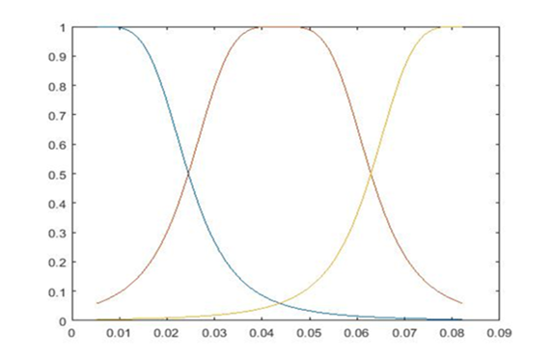
Result Analysis
ANFIS (Multi – Feature)
No. of training samples used: 180
No. of testing samples used: 20
No. of training epochs: 150
Threshold value: 2.65
Training method used: Error Backpropagation Training Algorithm (EBPTA)
Function used: anfis
Toolbox used: Neuro-Fuzzy Toolbox, Matlab 2015a
Input Membership Functions – Zero Crossing Rate
22
Department of Electronics and Communication Engineering, MIT, Manipal
Notes:
<number>

Slide 25
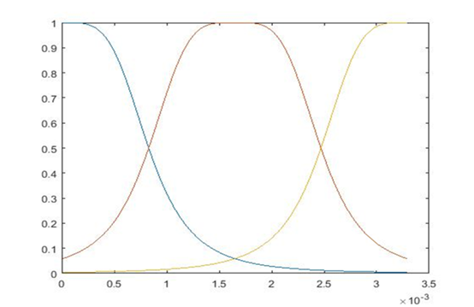
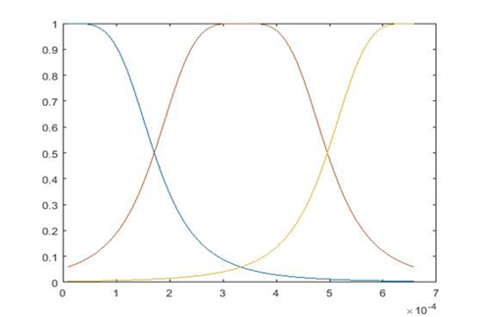
Result Analysis
Input Membership Functions – Short –Time Energy
Input Membership Functions – Energy Entropy
23
Department of Electronics and Communication Engineering, MIT, Manipal
Notes:
<number>

Slide 26
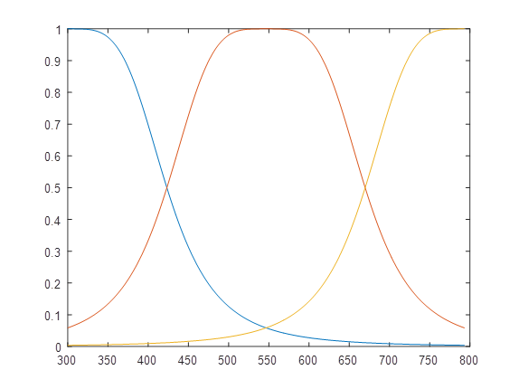
Result Analysis
Input Membership Functions-Formants
24
Department of Electronics and Communication Engineering, MIT, Manipal
Notes:
<number>

Slide 27
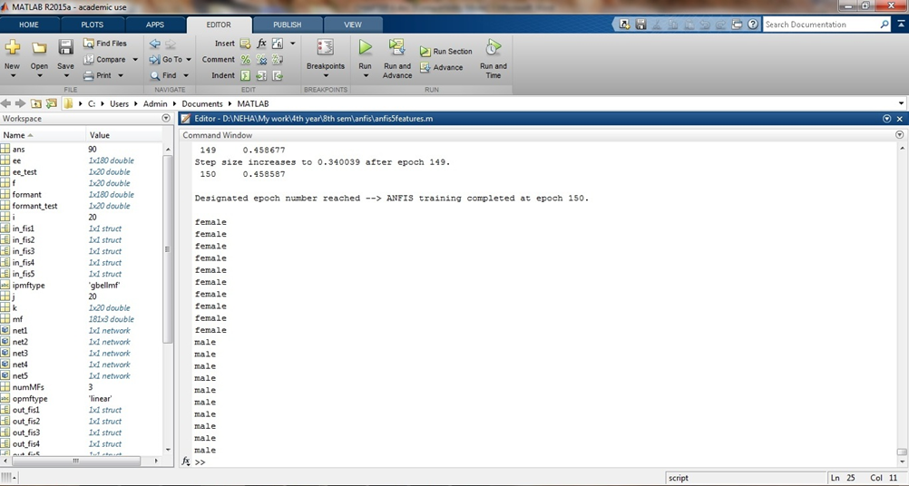
Result Analysis
Output Obtained:
Efficiency = ((10 + 10) / 20) * 100 %
= 100.00 %
25
Department of Electronics and Communication Engineering, MIT, Manipal
Notes:
<number>

Slide 28
Result Analysis
SVM (Multi – Feature)
No. of training samples: 180
No. of testing samples: 20
Negative Class ‘0’- Male
Positive Class ‘1’-Female
Threshold Value: 2.00
Training method used: Support Vector Machines
Function used: fitcsvm
Toolbox used: Statistics and Machine Learning Toolbox, Matlab 2015a
26
Department of Electronics and Communication Engineering, MIT, Manipal
Notes:
<number>

Slide 29
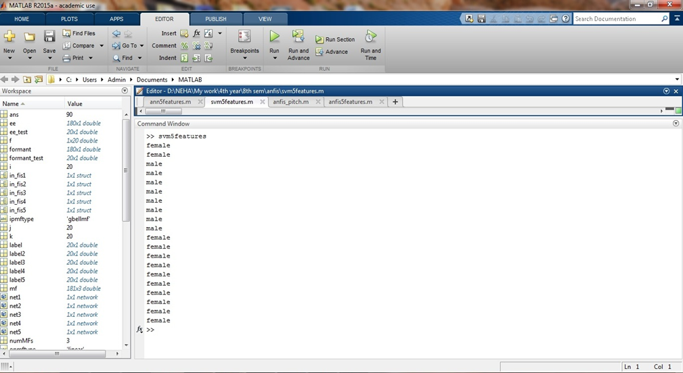
Result Analysis
Output Obtained:
Efficiency = ((10 + 8) / 20) * 100 %
= 90.00 %
27
Department of Electronics and Communication Engineering, MIT, Manipal
Notes:
<number>

Slide 30
Conclusion
The efficiencies obtained in all the methods are as follows:
METHOD USED | EFFICIENCY OBTAINED
ANN (Multi-Feature) | 90.00 %
SVM (Multi-Feature) | 90.00 %
ANFIS (using only Pitch as a feature) | 95.00 %
ANFIS (Multi-Feature) | 100.00 %
The following points can be concluded from the results obtained:
The pitch of the female speakers is significantly higher than the male speakers.
The normalized zero crossing rate values are also higher for the female speakers than the male speakers.
The normalized short-time energy values are slightly higher for the female speakers than the male speakers.
The normalized energy entropy values are also in general slightly higher for the female speakers than the male speakers.
28
Department of Electronics and Communication Engineering, MIT, Manipal
Notes:
<number>

Slide 31
Conclusion
The first formant frequencies are higher for the female speakers when compared to male speakers.
The Neural Network and Support Vector Machine classifiers have an efficiency of 90.00% in the multi-feature format.
The ANFIS network using only Pitch as a feature has an efficiency of 95.00%, showing improvement over the standard methods.
The multi-feature ANFIS gives an efficiency of 100.00% for the given dataset, hence rectifying the error arising from the exceptional case when using only Pitch as a discriminating factor.
This provides us with two important conclusions:
A multi-feature system is much more efficient than a system that relies on a single feature such as pitch, zero crossing rate, etc.
A neuro-fuzzy system, which incorporates the uncertainty handling benefit of fuzzy systems with the learning capability of neural networks, is a much better option than a standalone neural network or support vector machine classifier.
29
Department of Electronics and Communication Engineering, MIT, Manipal
Notes:
<number>

Slide 32
Future Work
The given system is only an initial block in what may be a sophisticated speaker and speech recognition engine.
It may be used in a variety of security systems for domestic as well as industrial purposes. Especially in financial transactions and maintaining databases in financial sectors, such a system could prove to be of great use.
The system can also be further modified to produce a gender recognition system which takes age also as a factor or an emotion recognition system which takes gender into consideration.
Such an emotion recognition system can be used for detection of pathological speech conditions for detection of diseases like Parkinson’s disease, etc.
30
Department of Electronics and Communication Engineering, MIT, Manipal
Notes:
<number>

Slide 33
References
Journal / Conference Papers
[1] Jyh-Shing Roger Jang, “ANFIS: Adaptive-Network-Based Fuzzy Inference System”, IEEE transactions on systems, man, and cybernetics, vol. 23, no. 3, May June 1993.
[2] Siva Prasad Nandyala and T. Kishore Kumar, "Real Time Isolated Word Speech Recognition System for Human Computer Interaction", International Journal of Computer Applications, Vol. 12, No. 2, pp. 1-7, Nov 2010.
[3] Sachin Lakra, Juhi Singh and Arun Kumar Singh , “Automated Pitch-Based Gender Recognition using an Adaptive Neuro-Fuzzy Inference System”, IEEE International Conference on Intelligent Systems and Signal Processing (ISSP), 2013
[4] Pawan Kumar, Nitika Jakhanwal, Anirban Bhowmick, and Mahesh Chandra, “Gender Classification Using Pitch and Formants”, ICCCS, February, 2011
[5] R. Rajeshwara Rao, A. Prasad, "Glottal Excitation Feature based Gender Identification System using Ergodic HMM", International Journal of Computer Applications, Vol. 17, No. 3, pp. 31-36, March 2011.
[6] Dr. K. Meena, Dr. K. R. Subramaniam, M. Gomathy, “Performance Analysis of Gender Clustering and Classification Algorithms”, International Journal on Computer Science and Engineering (IJCSE), Vol.4, 03 March 2012
31
Department of Electronics and Communication Engineering, MIT, Manipal
Notes:
<number>

Slide 34
References
[7] Yune-Sang Lee1, Peter Turkeltaub, Richard Granger, and Rajeev D. S. Raizada, "Categorical Speech Processing in Broca's Area: An fMRI Study Using Multivariate Pattern-Based Analysis", The Journal of Neuroscience, Vol.32, No.24, JAN 2012.
[8] Kadambe, S., & Srinivasan, P. (1994). Applications of adaptive wavelets for Speech. Optical Engineering, 33(7), 2204–2211.
[9] Sarikaya, R., & Hansen, H. L. (2000). High resolution speech feature parameterization for monophone-based stressed speech recognition. IEEE Signal Processing Letters, 7(7), 182–185.
[10] D. Nauck, F. Klawon; R. Kruse, “Foundations of Neuro-Fuzzy Systems”, J. Wiley & Sons, 1997.
[11] R. Jang, “Neuro-Fuzzy Modelling:Architectures, Analysis and Applications”, PhD Thesis, University of California, Berkley, July 1992.
Reference / Hand Books
[12] John R. Deller, Jr., John H.L. Hansen, John G. Proakis, “Discrete-Time Processing of Speech Signals”, IEEE Press, ISBN 0-7803-5386-2
[13] Lawrence R. Rabiner, Ronald W. Schafer, “Digital Processing of Speech Signals”, Prentice-Hall Signal Processing Series, ISBN 0-13-213603-1
Web
[14] www.wordpress.com/2011/04/20/hard-computing-vs-soft-computing
32
Department of Electronics and Communication Engineering, MIT, Manipal
Notes:
<number>

